Slide 1
Outline
Statistical Model
Terms
Probability of Pause Event:
Capacity Bounded Pause
Head-Of-Line (HOL) Blocking Pause
Analyze deadlock Case with Statistical Model

Slide 2
Outline
Statistical Model
Terms
Probability of Pause Event:
Capacity Bounded Pause
Head-Of-Line (HOL) Blocking Pause
Analyze deadlock Case with Statistical Model

Slide 3
Statistical Model - Terms
r₁ (> r^{c})
i
j
B
r^{c}
flow 1
rx
tx
rx
tx
pause
Time unit ∆t: the time for a device to send one packet to next-hop device.
Assumption: We assume a PAUSE frame can take effect immediately and lasts for ∆t.
Pause event pause(j, i, ∆t_{k}): pause(j, i, ∆t_{k}) =1 means switch j will pause switch i at time unit ∆t_{k}.
Pause probability P(pause(j, i, ∆t_{k})): the probability for event pause(j, i, ∆t_{k}) to occur.

Slide 4
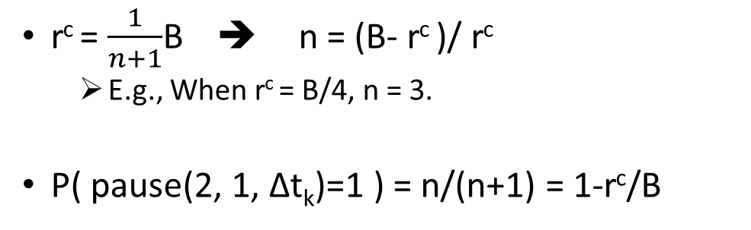
Statistical Model – Computation of P(pause(j, i, ∆t_{k}))
Case 1: Capacity Bounded Pause
r₁ (> r^{c})
1
2
B
r^{c}
flow 1
rx
tx
rx
tx
pause
P
Pause Event
P
…
P
T
P
…
P
T
……
P
…
P
T
Non-Pause Event
T
n
r^{c} = $\frac{1}{n+1}$B ➔ n = (B- r^{c} )/ r^{c}
E.g., When r^{c} = B/4, n = 3.
P( pause(2, 1, ∆t_{k})=1 ) = n/(n+1) = 1-r^{c}/B

Slide 5
Statistical Model – Computation of P(pause(j, i, ∆t_{k}))
Case 2: Head-of-Line Blocking Pause
r₁ (> r^{c})
1
2
B
r^{c}
flow 1
rx
tx
rx
tx
rx-2
pause
r^{c}
?
pause
P( pause(2, 1, ∆t_{k})=1 )=1-r^{c}/B when 2*r^{c} <= B
flow 2
3
tx
4
r₂
tx
rx
Question: P( pause(1, 4, ∆t_{k})=1 ) = ? when r₂ is set to different values.

Slide 6
Statistical Model – Computation of P(pause(j, i, ∆t_{k}))
Case 2: Head-of-Line Blocking Pause
r₁ (> r^{c})
1
2
B
r^{c}
flow 1
rx
tx
rx
tx
rx-2
pause
r₂
?
pause
flow 2
3
tx
4
r₂
tx
rx
Condition 1: r₂ < r^{c} → P( pause(1, 4, ∆t_{k})=1 ) = 0

Slide 7
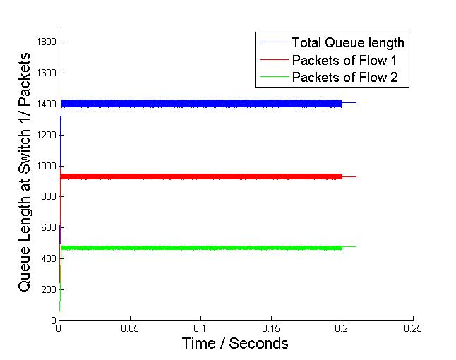
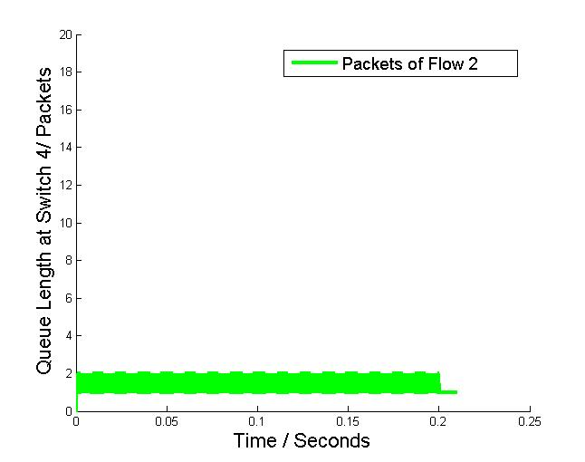
Statistical Model – Computation of P(pause(j, i, ∆t_{k}))
Simulation Results when setting r^{c} = B/2=20Gbps, r₂ =B/4=10Gbps:
1
1/2
Instant queue length of tx queue of switch 1
Instant queue length of tx queue of switch 4
At switch 1, queue length of flow 2 is half of flow 1’s, which complies with their drain rates at switch 1.
Almost no packets are queued at switch 4.

Slide 8
Statistical Model – Computation of P(pause(j, i, ∆t_{k}))
Case 2: Head-of-Line Blocking Pause
r₁ (> r^{c})
1
2
B
r^{c}
flow 1
rx
tx
rx
tx
rx-2
pause
r^{c}
?
pause
P( pause(2, 1, ∆t_{k})=1 )=1-r^{c}/B
flow 2
3
tx
4
r₂
tx
rx
Condition 2: r₂ = r^{c} → P( pause(1, 4, ∆t_{k})=1 ) = 1-r^{c}/B

Slide 9
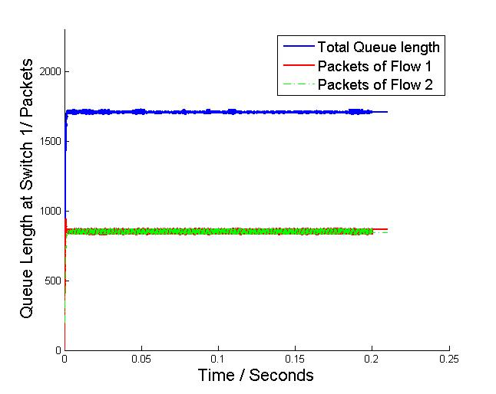
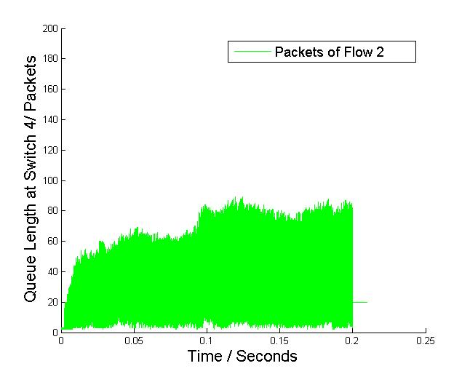
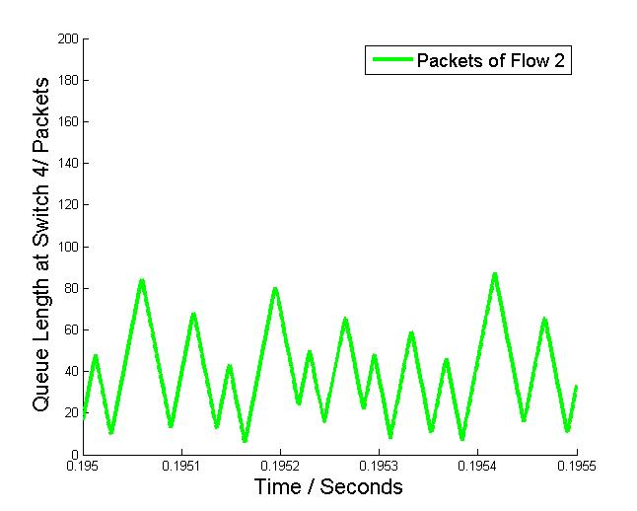
Statistical Model – Computation of P(pause(j, i, ∆t_{k}))
Simulation Results when setting r^{c} = B/2=20Gbps, r₂ =B/2=20Gbps:
Instant queue length of tx queue of switch 1
Instant queue length of tx queue of switch 4
At switch 1, queue length of flow 2 is the same as flow 1’s, which complies with their drain rates at switch 1.
Some packets are queued at switch 4. Switch 4 is paused by switch 1 intermittently.

Slide 10
Statistical Model – Computation of P(pause(j, i, ∆t_{k}))
Case 2: Head-of-Line Blocking Pause
r₁ (> r^{c})
1
2
B
r^{c}
flow 1
rx
tx
rx
tx
rx-2
pause
r^{c}
?
pause
P( pause(2, 1, ∆t_{k})=1 )=1-r^{c}/B
flow 2
3
tx
4
r₂
tx
rx
Condition 3: r₂ > r^{c} → P( pause(1, 4, ∆t_{k})=1 ) = 1-r^{c}/B

Slide 11
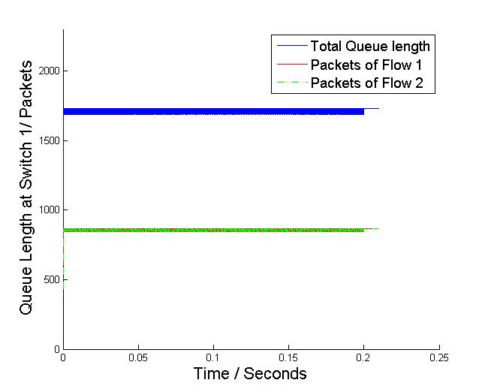
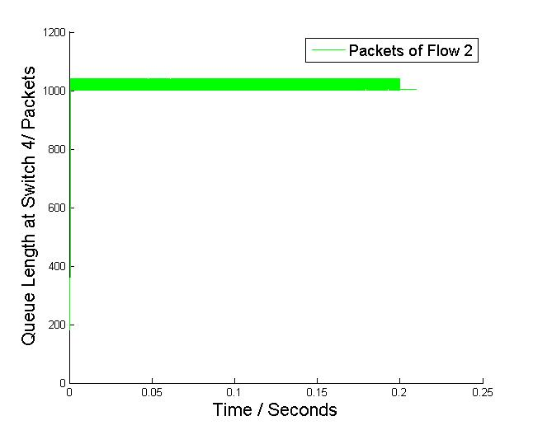
Statistical Model – Computation of P(pause(j, i, ∆t_{k}))
Simulation Results when setting r^{c} = B/2=20Gbps, r₂ =B=40Gbps:
Instant queue length of tx queue of switch 1
Instant queue length of tx queue of switch 4
At switch 1, queue length of flow 2 is the same as flow 1’s, which complies with their drain rates at switch 1.
Packets are queued at switch 4 and exceed PFC threshold. Switch 4 is paused by switch 1 intermittently.

Slide 12
Outline
Statistical Model
Terms
Probability of Pause Event:
Capacity Bounded Pause
Head-Of-Line (HOL) Blocking Pause
Analyze deadlock Case with Statistical Model

Slide 13
Analyze Deadlock Case with Statistical Model
Case 1:
flow 2
r₂ = B
A
rx
tx
r₁ = B
r₃ = B
flow 1
B
C
tx
rx
rx
flow 3
tx
Injection rates of three flows are B.

Slide 14
Analyze Deadlock Case with Statistical Model
Case 1:
flow 2
r₂ = B
A
rx
tx
r^{c} = B/2
r₁ = B
P = 0.5
r₃ >= B/2
r₃ = B
flow 1
B
C
tx
rx
rx
flow 3
tx
Tx queues of switches A, B and C are equivalent. We consider the pause event from B to C.
As we have r3 >= B/2 at the link C-B, P( pause(B, C, ∆t_{k})=1 ) = 1-r^{c}/B = 0.5

Slide 15
Analyze Deadlock Case with Statistical Model
Case 1:
flow 2
r₂ = B
A
rx
tx
P = 0.5
P = 0.5
r₁ = B
P = 0.5
r₃ = B
flow 1
B
C
tx
rx
rx
flow 3
tx
Probability of deadlock event = 0.5^3 = 0.125 >0, deadlock can occur.
NS-3 simulation shows that deadlock will occur in this case.

Slide 16
Analyze Deadlock Case with Statistical Model
Case 2:
r₁ = B
S1
S2
Flow 1
tx
rx
rx
tx
r₂ = B
tx-1
rx
Rate limiting = B/2
S4
S3
Flow 2
tx-2
rx
tx
Injection rates of both flows are B.

Slide 17
Analyze Deadlock Case with Statistical Model
Case 2:
r₁ = B
S1
S2
Flow 1
tx
rx
rx
P = 0.5
tx
P = 0.5
tx-1
rx
Rate limiting = B/2
S4
S3
tx-2
rx
tx
r₁ = B/2
Consider flow 1 at first.

Slide 18
Analyze Deadlock Case with Statistical Model
Case 2:
r₁ = B
S1
S2
Flow 1
tx
rx
rx
P = 0.5
tx
r₂ = B/2
P = 0.5
P = 0.5
r₂ = B
tx-1
P = 0
rx
Rate limiting = B/2
S4
S3
Flow 2
tx-2
rx
tx
r₁ = B/2
P = 0.5
Probability of deadlock event = 0.5^3*0 = 0, deadlock can occur.
NS-3 simulation shows that deadlock will not occur in this case.

Slide 19
Analyze Deadlock Case with Statistical Model
Case 3:
flow 3
r₃ = B
r₁ = B
S1
S2
Flow 1
tx
rx
rx
tx
r₂ = B
tx-1
rx
Rate limiting = B/2
S4
S3
Flow 2
tx-2
rx
tx
Injection rates of three flows are B.

Slide 20
Analyze Deadlock Case with Statistical Model
Case 3:
flow 3
r₃ = B
r₁ = B
P = 0.5
S1
S2
Flow 1
tx
rx
rx
P = 0.5
tx
r₁ = B/2
P = 0.5
tx-1
rx
Rate limiting = B/2
S4
S3
tx-2
rx
tx
r₁ = B/2
r₃ = B/2
Consider flow 1 and flow 3. Rate limiting at tx-2 queue of S4 will no longer take effect.

Slide 21
Analyze Deadlock Case with Statistical Model
Case 3:
flow 3
r₃ = B
r₁ = B
P = 0.5
S1
S2
Flow 1
tx
rx
rx
P = 0.5
tx
r₂ = B/2
P = 0.5
P = 0.5
r₂ = B
tx-1
P = 0.5
rx
Rate limiting = B/2
S4
S3
Flow 2
tx-2
rx
tx
r₁ = B/2
Probability of deadlock event = 0.5^4 > 0, deadlock can occur.
NS-3 simulation shows that deadlock will occur in this case.

Slide 22
Analyze Deadlock Case with Statistical Model
Case 4:
flow 3
flow 4
r₃ = B
r₄ = B
r₁ = B
S1
S2
Flow 1
tx
rx
rx
tx
r₂ = B
tx-1
rx
Rate limiting = B/2
S4
S3
Flow 2
tx-2
rx
tx
Injection rates of four flows are B.

Slide 23
Analyze Deadlock Case with Statistical Model
Case 4:
flow 3
flow 4
r₃ = B
r₄ = B
r₁ = B
S1
P = 2/3
S2
P = 2/3
Flow 1
tx
rx
rx
P = 2/3
tx
r₂ = B/3
P = 2/3
P = 2/3
r₂ = B
tx-1
P = 2/3
rx
Rate limiting = B/2
S4
S3
Flow 2
tx-2
rx
tx
r₁ = B/3
Probability of deadlock event = (2/3)^4 >0, deadlock can occur.
NS-3 simulation shows that deadlock will occur in this case.

Slide 24
Analyze Deadlock Case with Statistical Model
Case 4:
r₁ = B
S1
S2
Flow 1
tx
rx
rx
P = 0.5
tx
P = 0.5
tx-1
rx
Rate limiting = B/2
S4
S3
tx-2
rx
tx
r₁ = B/2
Consider flow 1 at first.

Slide 25
Analyze Deadlock Case with Statistical Model
Case 4:
flow 3
flow 4
r₃ = B
r₄ = B
r₁ = B
S1
P = 2/3
S2
P = 2/3
Flow 1
tx
rx
rx
P = 2/3
tx
tx-1
rx
Rate limiting = B/2
S4
S3
tx-2
rx
tx
r₁ = B/3
Consider flow 3 and flow 4.

